Slide 1
Neurosonology testing in non-atherosclerotic carotid disease
Arijana Lovrencic-Huzjan
UHC Sestre milosrdnice
Zagreb, Croatia

Slide 2
Non-atherosclerotic disease
No rear
Dissection
Fibromuscular dyplasia
Vasculitis
Geneticaly mediates arteriopaties
Anatomic variants

Slide 3
Neurosonology in craniocervical artery dissection
Advantages:
Diagnostic of the disease
Antithrombotic treatment, prognostic
Monitoring of the disease
Morphologic and hemodynamic features, HITS
Recanalization and recurrence rate
Duration of antithrombotic treatment
Pitfalls:
Acute setting
Localisation of the disease

Slide 4
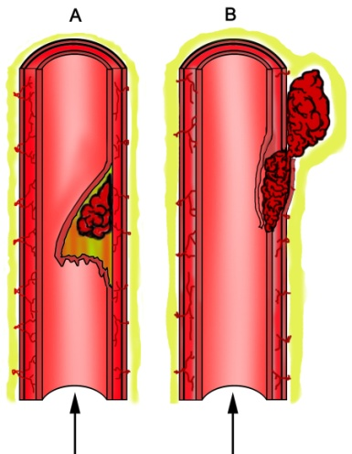
Spontaneous craniocervical artery dissection (sCAD)
Corresponds to a hematoma in the wall
of the internal carotid or vertebral artery.
The most common single etiology of stroke.
The diagnosis is challenging due to diverse clinical picture ranging from headache to ischemic stroke and subarachnoid hemorrhage (SAH).
Therapeutic options depend on the localization and extent of the dissection.
Debette S. Pathophysiology and risk factors of CAD. Curr Opin Neurol 2014; 27: 20-28.
Engelter ST, et al. for the CADISP. Neurology 2013; 80: 1950-1957.
Metso TM, et al. for the CADISP. Neurology 2012; 78: 1221-8.
Bejot Y, et al on behalf of the CADISP Group. Stroke 2014; 45: 37-41.

Slide 5
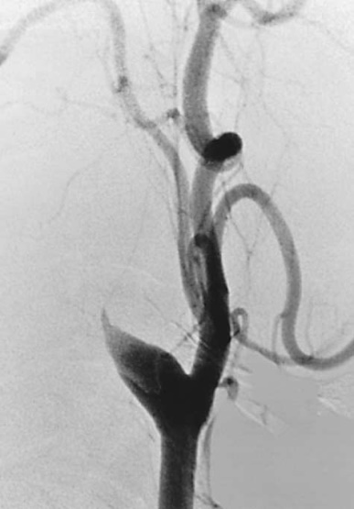
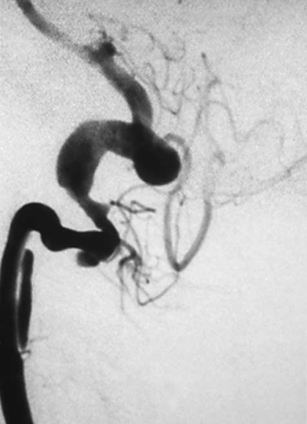
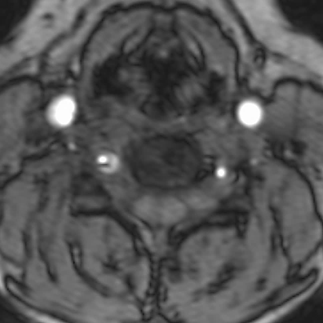
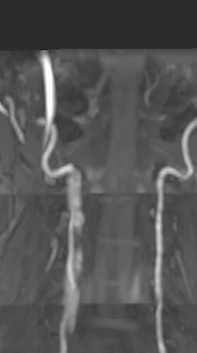
Imaging of extracranial dissection
Catheter angiography:
tapered, flame-like, occlusion,
smooth or slightly irregular luminal narrowing,
pseudoaneurysm (in 1/3 of pts.),
intimal flap or double lumen (specific, in <10%),
distal branch occlusion.
MR images (SE 50-100%, SP 29-100%):
eccentric or circumferential periarterial rim
intramural hematoma - hyperintense signal
T1 and T2 weighted images.
CTA: SE 51-100%, SP 67-100%
Requires more expertise
Available
Houser OW, Mokri B et al. AJNR Am J Neuroradiol 1984;5:27-34.
Provenzale JM, Sarikaya B. AJNR 2009;193:1167-74
Rodallec MH,et al. RadioGraphics 2008;28:1711–28 Hanning U,et al. J Neuroimaging 2017;27:607-12.

Slide 6
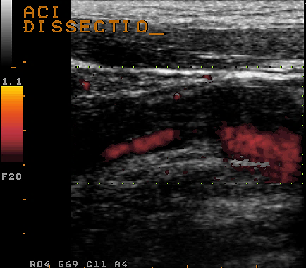
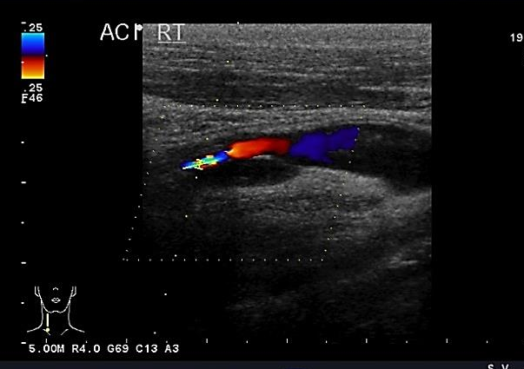
Neurosonology – SE 80-96%
Direct signs:
echolucent intramural hematoma, string sign
double lumen
stenosis and/or occlusion of an arterial segment usually not affected by atherosclerosis: distal part of the ICA, V2-V4 segment of the VA
Nebelsieck J et al. J Clinical Neurosci 2009; 16: 79-82.
Lovrenčić-Huzjan A et al. Acta clin Croat 2002; 41: 307-312.
de Bray JM et al. J Ultrasound Med 1994;13: 59-64.
Sturzenegger M et al. Stroke 1993; 24: 1910-21.

Slide 7
Intimal flap
Specific, but rear finding

Slide 8
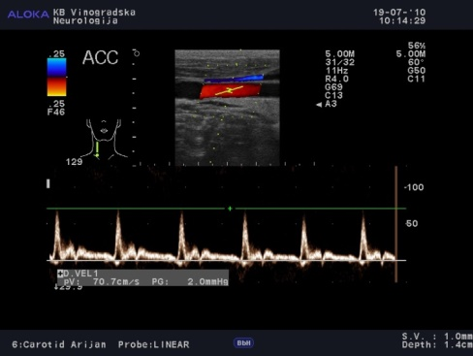
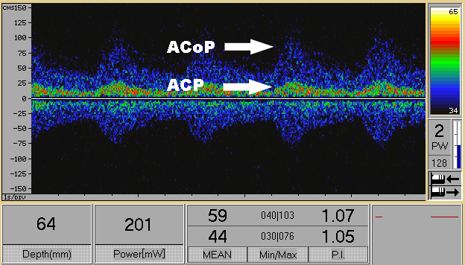
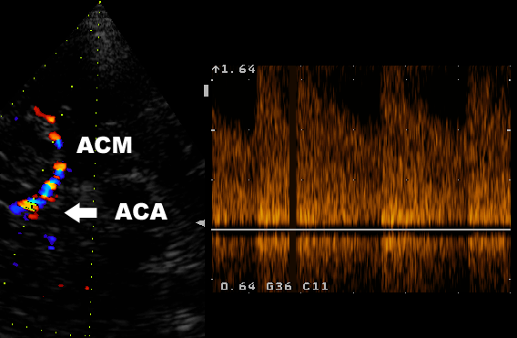
Indirect sign
Increased or decreased pulsatility upstream or downstream of the suspected arterial lesion
>50% difference in the BFV compared to the same segment of the artery on the unaffected side
Detection of intracranial collateral flow
Nebelsieck J et al. J Clinical Neurosci 2009; 16: 79-82.
Lovrenčić-Huzjan A et al. Acta clin Croat 2002; 41: 307-312.
de Bray JM et al. J Ultrasound Med 1994;13: 59-64.
Sturzenegger M et al. Stroke 1993; 24: 1910-21.

Slide 9
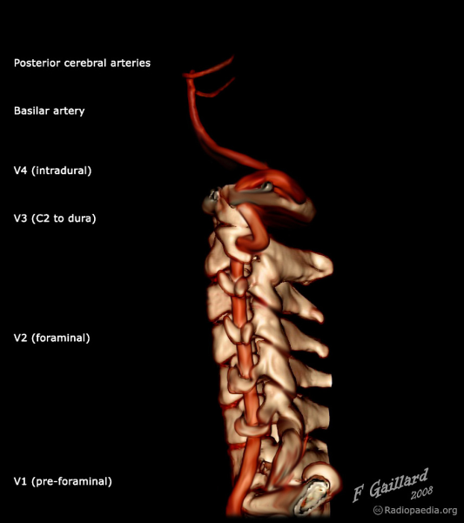
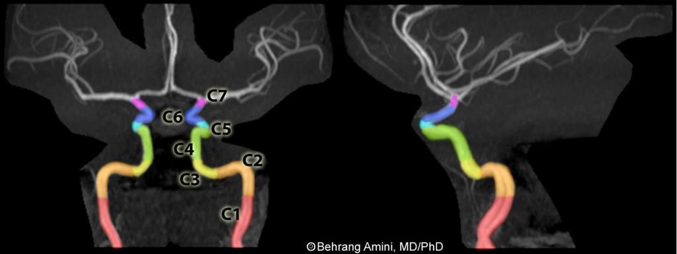
Challenges in diagnosing dissection
Time course - multiple artery involvement seems frequent or may develop during time.
Localisation of the dissection may be overlooked:
V3 segment of the vertebral artery,
ICA distal cervical, subpetrous segment.
Debette S. Neurology 2011

Slide 10
Pseudoaneurisym may be missed

Slide 11
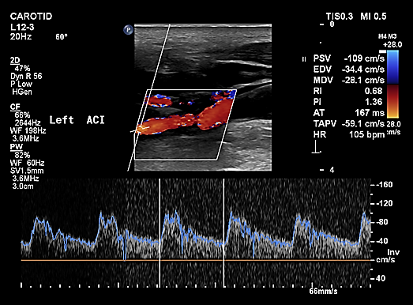
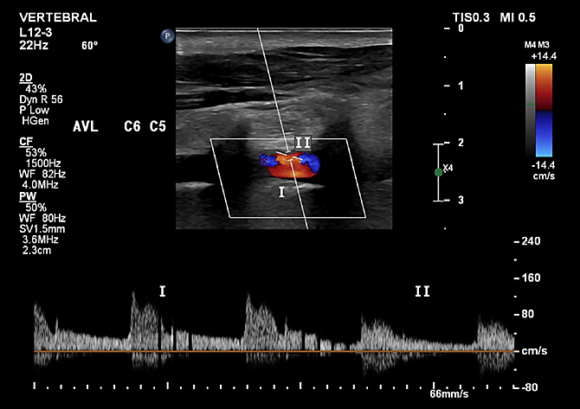
Case 1.
Headache
Hypertension
Smoker
Horner syndrome
Carefull hystory taking: fell from ladder on the left shoulder 3 months earlier

Slide 12
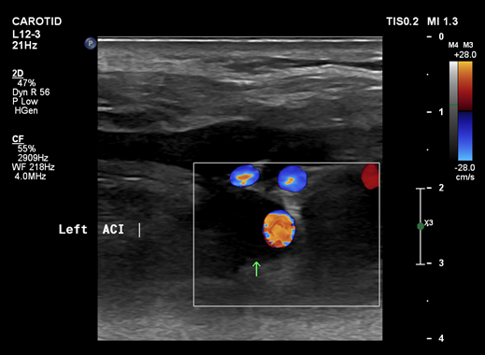

Slide 13
Take home massage I
Clinical picture + neurosonology finding: pointing on the disease
Carefull history taking for trauma

Slide 14
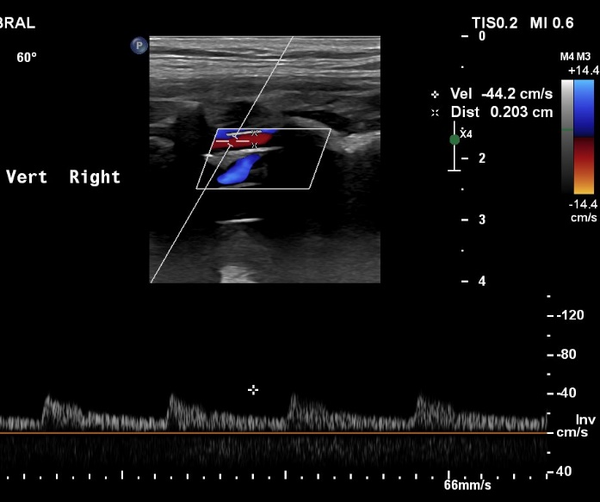
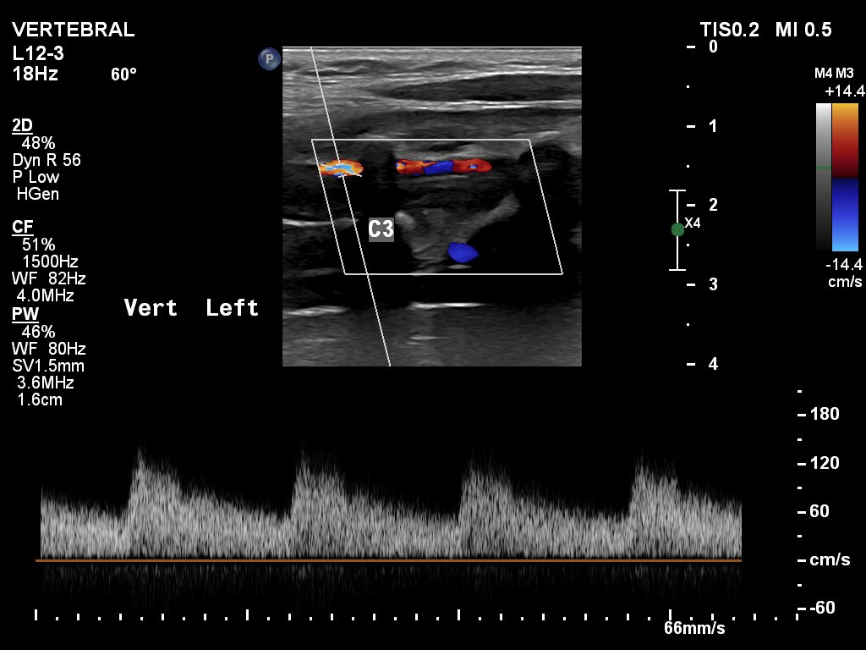
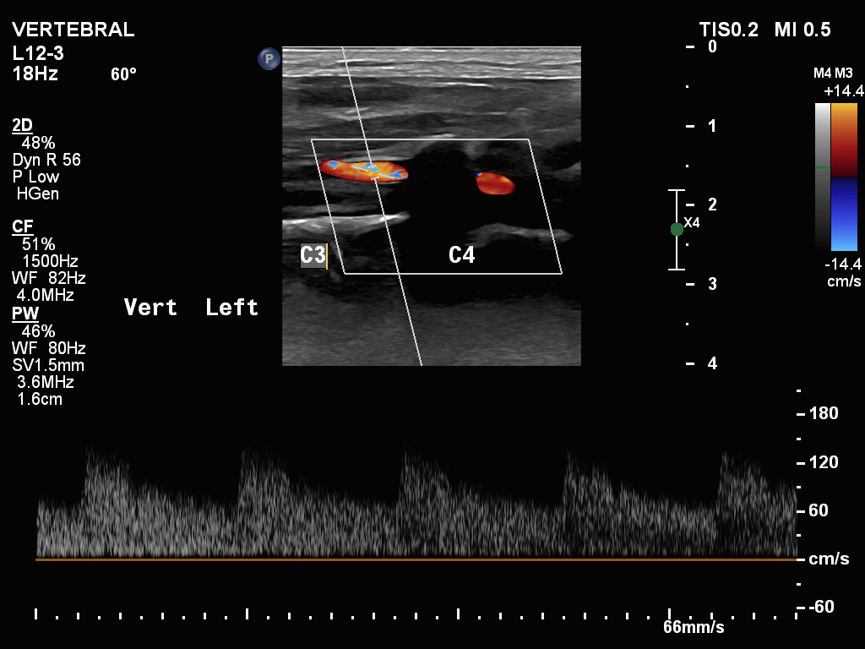
Recurrence or time course of the dissection?
Female patient born 1991. y.
Headache, neckpain 2 weeks earlier
Left vertebral artery hemathoma

Slide 15
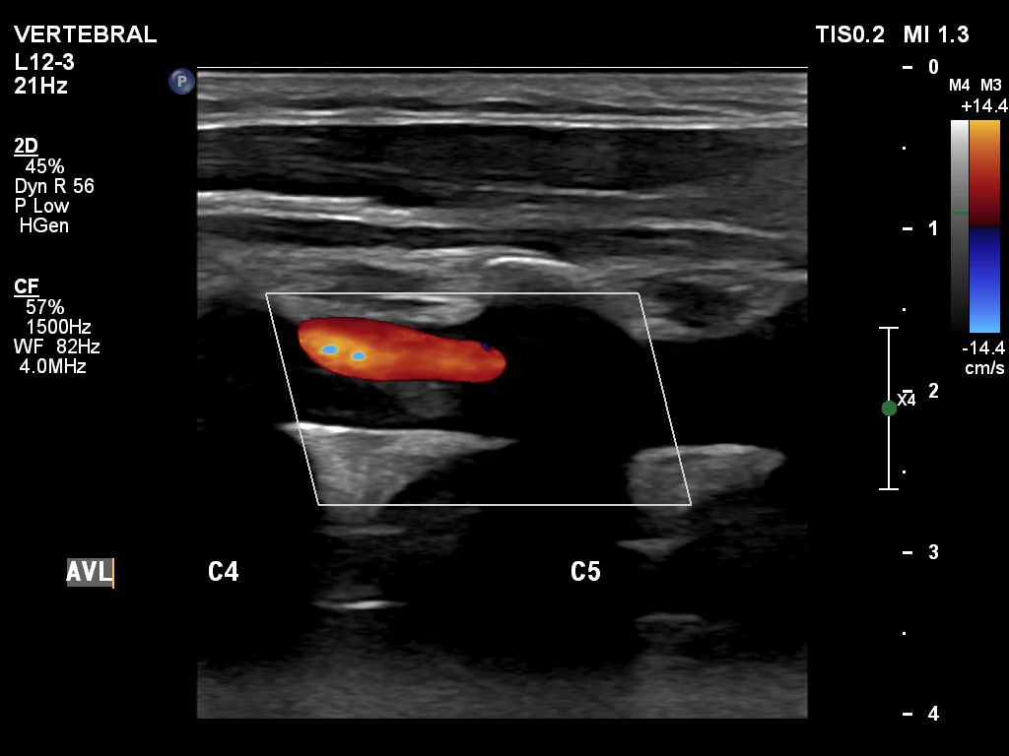
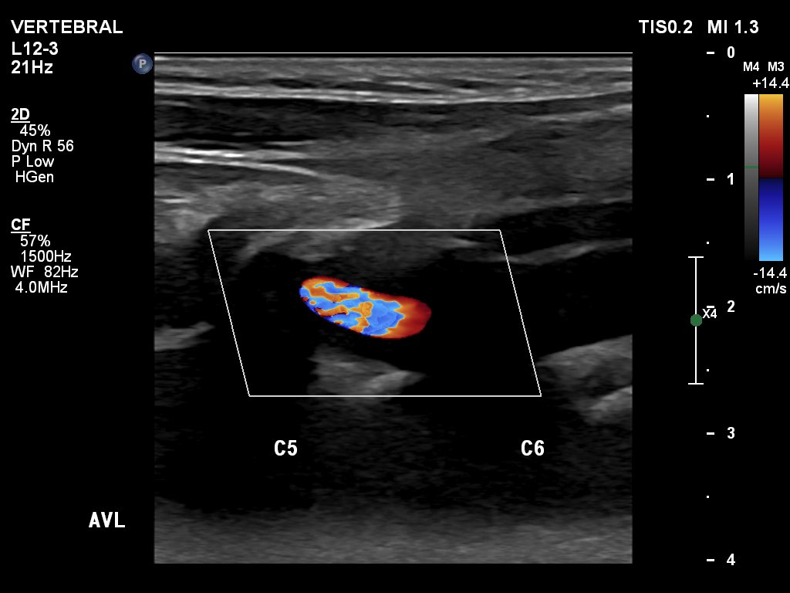
Follow up after 5 days

Slide 16
Left vertebral artery

Slide 17
Right vertebral artery – previously unaffected

Slide 18
Left vertebral artery – further follow up: enlargement of the hemathoma

Slide 19
Follow up – beginning of the recanalization in V3 segment

Slide 20
Follow up - regression

Slide 21
Take home message II
Longer follow up:
Watch for dissection in previously unaffected artery: usualy carotid-carotid, or vertebral-vertebral artery

Slide 22
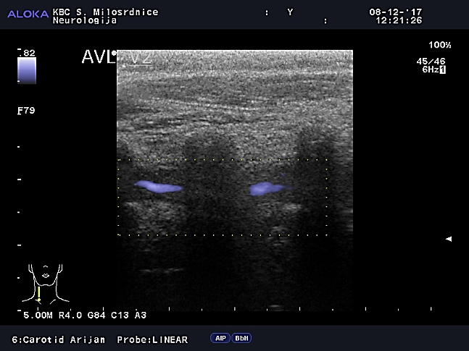
Challenges in diagnosis
Olygosyptomatic patients with atypical localisation:
dissection affecting the carotid bulb,
longer hypoechoic atherosclerotic plaque,
Giant cell arteritis.
Contrast enhancement
Garcia-Garcia J, et al. Stroke 2011;42
Chomlak L. Clin Med Insig: Arthr Musculoskel Dis 2016;9
Reinhard M, et al. J Neurol 2003; 250:1006

Slide 23
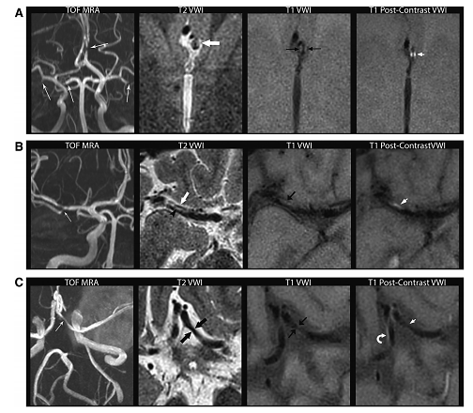
VW MRI to discriminate ICAD, vasculitis and RCVS
A ICAD
T2VW: homogeneous isointense
signal intensity
T1VW: postcontrast circumferential
vessel wall enhancement
B vasculitis
T2VW: juxtaluminal T2 hyperintense
band with subjacent lesional hypointensity
T1VW: postcontrast heterogeneous
lesional enhancement
C RCVS
T2 VWI:minimal wall thickening with T2
isointense signal
T1 VW: postcontrast no evidence of
significant wall enhancement
but mild perivascular venous enhancement enhancement
Mossa-Basha M, et al.
Stroke 2015;46:1567–73
Notes:
Vessel wall magnetic resonance imaging (VWI) findings of vasculitis (VS; A), intracranial atherosclerotic disease (ICAD; B), and reversible cerebral vasoconstriction syndrome (RCVS; C). A, Vasculitis: coronal maximum intensity projection (MIP) time of flight (TOF) magnetic resonance angiography (MRA) (left) shows multifocal arterial stenosis involving the left A2 anterior cerebral artery (ACA), bilateral middle cerebral artery (MCA), and right P1 posterior cerebral artery (white arrows). On T2 VWI (left middle) centered over the left ACA lesion, there is circumferential vessel wall thickening with homogeneous isointense signal intensity (thick arrow). On T1 precontrast image (right middle), circumferential vessel wall thickening (black arrows) can be seen. On T1 postcontrast VWI (last image), there is corresponding homogeneous, circumferential vessel wall enhancement (short arrow). B, Atherosclerosis: coronal MIP TOF MRA image (first image) shows stenosis of the distal right M1 MCA (arrow). On T2 VWI (left middle), there is a juxtaluminal T2 hyperintense band (black arrowhead), with subjacent lesional hypointensity (thick white arrow) corresponding to the MRA stenosis. On T1 precontrast VWI (right middle image), isointense lesion shows eccentric anterior vessel wall involvement (black arrow). On T1 postcontrast VWI (last image), there is heterogeneous lesional enhancement (short white arrow). C, RCVS: axial MIP TOF MRA image (first image) shows multifocal intracranial arterial stenosis, with focal stenosis of the left A1 ACA (white arrow). Axial T2 VWI (left middle image) shows corresponding minimal wall thickening with T2 isointense signal (thick black arrows) at the site of left A1 ACA lesion. On axial T1 precontrast VWI (right middle), there is minimal circumferential vessel wall thickening (thin black arrows) corresponding to the stenosis. On T1 postcontrast VWI (last image), there is no evidence of significant wall enhancement (short white arrow). The contralateral A1 ACA, a normal arterial segment on MRA shows mild perivascular enhancement (curved arrow) likely representing venous enhancement

Slide 24
Challenges in diagnosis
Carotid dissection – spreading from aortic dissection

Slide 25
Take home massage III
Other imaging modalities can differentiate from other disease

Slide 26
Overlap with other vascular disorders
Fibromuscular dysplasia (FMD)
non-inflammatory, non-atherosclerotic disorder affecting primary renal and cervical arteries
US FMD registry: renal 79.7%, CA 74.3%
patients with CA involvement: 95% ICA, 60-80% VA, 65% both
60,2% intracranial imaging, 12,9% intracranial aneurysm(s)
447 patients with FMD, 18.3% dissection – RISK FACTOR FOR CAD
13% CA, 3.6% renal arteires, 3.4% VA
Multiple dissections more common (18.5 vs 15%)
FMD in CAD: 5.6% - 21%, ARCADIA-POL 39.5%
Touze E et al. Int J Stroke 2010; 5: 296-305.
Bejot Y, et al. Stroke 2014; 45: 37-41.
Olin J. Circulation 2012., Lather H. JAMA Neurol 2017;74:1081
Lovrencic-Huzjan A. Perspectives in Medicine 2012.
Talarowska P. Vasc Med 2019; 24:112-9.

Slide 27
Limitation of FMD estimates in sCAD
No standardized protocol to seek for FMD in sCAD patients
Current large series of CAD patients from neurology departments with less expertise in FMD.

Slide 28
sCAD can also be asymptomatic
sCAD goes frequenty undiagnosed
Discovered through routine examination
Several cases of asymptomatic or oligosymptomatic sCAD probably remain undiagnosed
Grond-Gisbach C, et al. Medical Hypotheses 2013; 80: 787-90.
Debette S, Leys D. Lancet Neurol 2009; 8: 668-78.
Debette S. Curr Opin Neurol 2014; 27: 20-28.

Slide 29
Selection of antithrombotic treatment
Empirical rather than evidence based
Anticoagulation or antiplatelets in the acute phase: to prevent recurrent ischemic events
No randomized trial has been done to assess and compare the efficacy of these treatments
A systematic review and meta-analysis of 36 observational studies: no significant differences between anticoagulation and antiplatelet treatment for clinical outcomes or risk of recurrent stroke.
Engelter ST, et al. for the CADISP Study Group. Stroke 2007; 38: 2605-11.
Lyrer P et Engelter S. Antithrombotic drugs for carotid artery dissection. Cochrane
Database Syst Rev 2010; CD0000255.

Slide 30
CADISS: Antiplatelet vs anticoagulation
Diagnosis of dissection could not be centrally
conﬁrmed on imaging review in 52 pts
Patients enroled within the past 7 days from symptom onset
Randomly assigned to antiplatelet or anticoagulation: choice of antiplatelet drugs was at the discretion of the clinician
Observational arm-stroke: 1/59 antiplatelets, 1/28 anticoagulants
Weakness: Some patients with early, severe, recurrent dissection were not included
CADISS. Lancet Neurol 2015; 14: 361–67.
Kennedy F, et al. for CADISS. Neurology 2012; 79: 686-9.

Slide 31
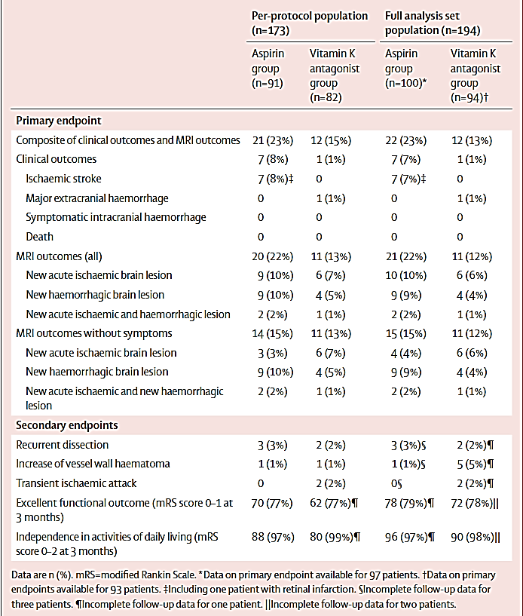
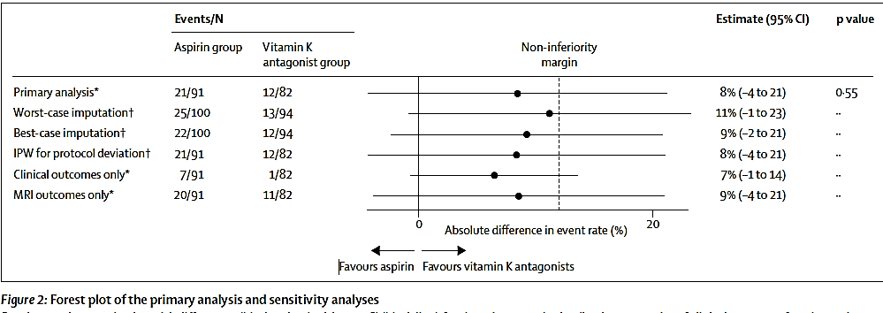
TREAT-CAD Non-inferiority of ASA was not confirmed
- ASA 300 mg vs vit K antagonist
Primary endpoint: composite of clinical outcomes (stroke, major haemorrhage, or death) and MRI outcomes (new ischaemic or haemorrhagic brain lesions) at 14 days (clinical and MRI outcomes) and 90 days (clinical outcomes only) after commencing treatment.
Primary endpoint occurred in 21 (23%) of 91 patients in the ASA group and in 12 (15%) of 82 patients in the vit K antagonist group (abs diff. 8% [95% CI –4 to 21], non-inferiority p=0·55
Engelter ST, et al. Lancet Neurol 2021; 20: 341–50.
Traenka C, et al. Eur Stroke J 2020; 5: 309–19.

Slide 32
Anticoagulants or antiplatelet th.
AHA/ASA guidelines: both options for 3-6 months (class IIa, level B).
The decision should be made on a case-by-case basis
Algoritham to help with this decision
Neurosonology may help in clinical guiding management.
Jauch EC, at al. AHA/ASA. Stroke 2013; 44: 870-947.
Kernan WN, et al. AHA/ASA. Stroke 2014; 45: 2160-236.
Engelter ST, et al. for the CADISP Study Group. Stroke 2007; 38: 2605-11.
Lyrer P et Engelter S. Stroke 2004; 35: 613-4.

Slide 33
Arguments in favor of anticoagulation
Stroke in sCAD - a consequence of embolism originating from the injured intima.
Arguments supporting embolic mechanism: observation of microemboli,
HITS in sCAD: 25-60% (sample size small)
the occurrence of distal branch occclusion
(14-50%)
the infarct pattern on brain scans
DWI MRI – 71% multiple DWI lesions.
Lucas C, et al. Stroke 1998;29:2646-48. Lovrencic-Huzjan A et al. Acta Clin Croat 2002;41:307-12.
Molina CA, et al. Neurology 2000;55:1738-40. Koch S, et al. Arch Neurol 2004;61:510-12.

Slide 34
In favor of immediate anticoagulation
HITS despite (dual) antiplatelets
HITS more frequent in patients with recurrent ischemia
HITS surrogate marker of “microclots”
Multiple TIA/strokes affecting multiple regions (same circulation) suggesting repetitive emboli
Engelter ST, et al. for the CADISP Study Group. Stroke 2007; 38: 2605-11.
Droste DW, et al. Cerebrovasc Dis 2001; 12: 181-5.
Lovrencic-Huzjan A et al. Acta Clin Croat 2002; 41: 307-12.
Molina CA, et al. Neurology 2000; 55: 1738-40.

Slide 35
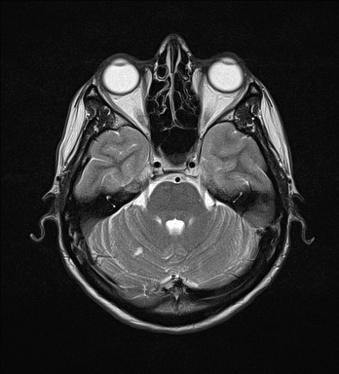
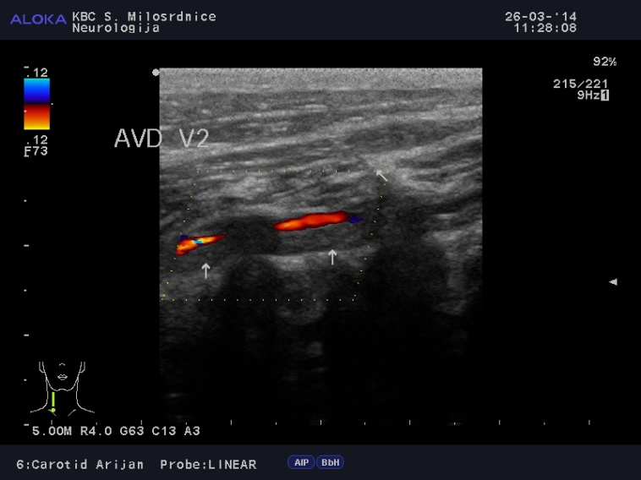
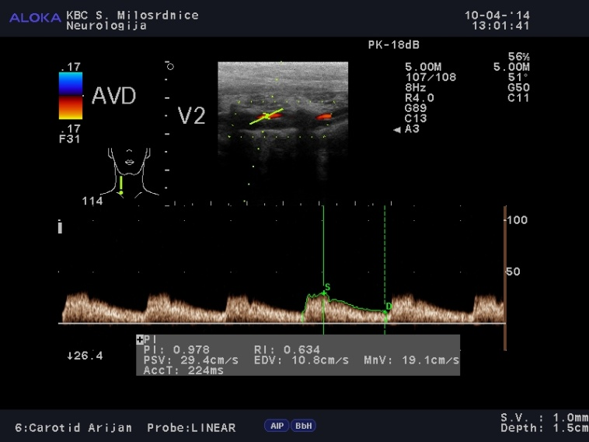
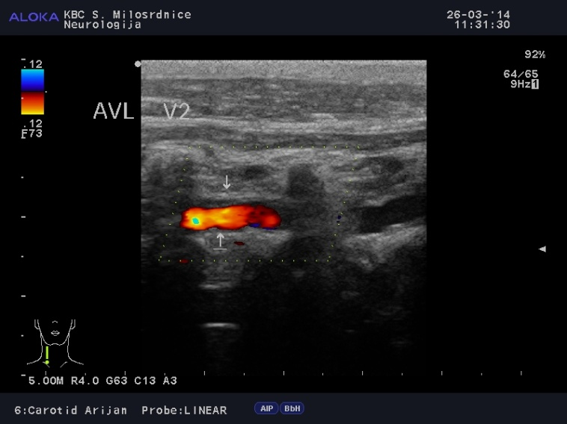
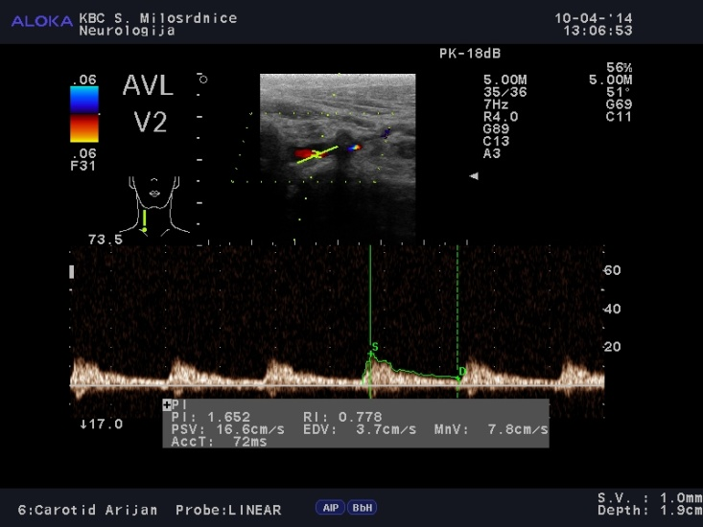
Multiple cerebellar strokes due to both vertebral artery dissection

Slide 36
In favor of immediate anticoagulation
Occlusion /pseudo-occlusion, if the infact is not too large (NIHSS score > 15)
Embolization may occur during recanalization
Applying general ASA guidelines for anticoagulation
Engelter ST, et al. for the CADISP Study Group. Stroke 2007; 38: 2605-11.
Brandt T et al. in: Schlaganfall. Stuttgart: Thieme 2004: 176-81.
TOAST. JAMA 1998; 279: 1265-72.
Adams HP Jr, et al. Stroke Council of the ASA. Stroke 2003; 34: 1056-83.

Slide 37
In favor of immediate anticoagulation
Free-floating thrombus
Engelter ST, et al. for the CADISP Study Group. Stroke 2007; 38: 2605-11.
Combe J, et al. Ann Vasc Surg 1990; 4: 558-62.
Cardon A, et al. J Chir (Paris) 1992; 129: 324-6.

Slide 38
In favor of antiplatelets
Severe stroke exposing the individual to a high risk of hemorrhagic transformation
No brain imaging available (sCAD may present with bleeding)
Accompanying intracranial dissection
Bleeding risk increased in intracranial dissection, eg. vertebral artery dissection.
Engelter ST, et al. for the CADISP Study Group. Stroke 2007; 38: 2605-11.
Adams HP Jr, et al. Stroke Council of the ASA. Stroke 2003; 34: 1056-83.
Kaplan SS, et al. Stroke 1993; 1397-99.

Slide 39
In favor of antiplatelets
Local compression syndromes without stroke/TIA
Subadventitial dissection may have less risk for ischemic events
Horner sy - more benign clinical course
Concomitant diseases with increased bleeding risk (extra/intracranial)
Insufficient intracranial collaterals
Engelter ST, et al. for the CADISP Study Group. Stroke 2007; 38: 2605-11.
Baumgartner RW, et al. Neurology 2001; 57: 827-32.
Lyrer PA, et al. CADISP. Neurology. 2014; 82:1653­9.
Kalra R, et al. Stroke 1999; 30: 1218-22.

Slide 40
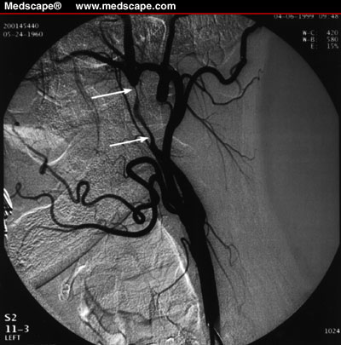
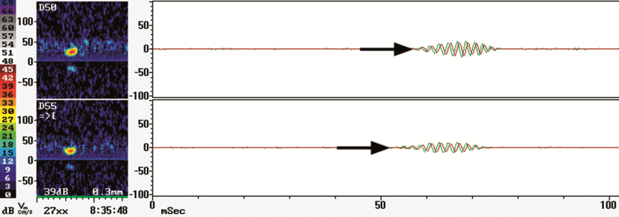
Neurosonology monitoring
The course of dissection
Possibility of monitoring therapeutic effect
Limitation - C2 segment
or intracranial localization
Sturzenegger M et al. Stroke 1993; 24: 1910-21.
Steinke W et al. Stroke 1994; 25: 998-1005.
Lovrenčić-Huzjan A et al. Acta clin Croat 2002; 41: 307-312.

Slide 41
Daily neurosonological monitoring
In 20/76 pts (26.3%) a new dissection (confirmed by MRI) in one or more previously unaffected cervical vessels:
a comparable rate for men (41%) and woman (43%, p=0.84)
for ICAs (55%) and VAs (45%, p=0.75).
Most of early recurrences were oligosymptomatic (headache or neck pain) or asymptomatic.
Baracchini C, et al. Neurology 2010; 75: 1864-70.

Slide 42
Monitoring the embolic signals in correlation with clinical findings
MES regression with anticoagulant therapy, clinical amelioration.
Worsening of clinical findings with persistent or increased MES.
Lovrenčić-Huzjan A et al. Acta clin Croat 2002; 42: 201-205.
Molina CA et al. Neurology 2000; 55: 1738-1741.
Koennecke HC et al. J Neuroimag 1997; 7: 217-220.

Slide 43
Duration of therapy
Unknown, guided on the previous reports of the recurrence rate and outcomes
Anticoagulants - usually maintained up to 6 months
Long term prevention of cerebral ischemia with antiplatelets
empirical arguments in cases of residual stenosis, occlusion or aneurysm
it was not proved that these patients have an increased risk of recurrence of ischemic events.
Neurosonology enables monitoring.

Slide 44
Fibromuscular dysplasia (FMD)
Non-atherosclerotic, non-inflammatory underdiagnosed vascular disease.
Affects medium sized muscular arteries, mostly renal, carotid and vertebral arteries.
It may result in arterial stenosis, occlusion, aneurysm, or dissection.
The prevalence in the general population is not known.
Females/males: 9/1.

Slide 45
Clinical manifestations of FMD
Determined by the vessels that are involved.
Renal artery: hypertension
Carotid or vertebral artery: headache, dizziness, pulsatile tinnitus, transient ischemic attack (TIA), or stroke.
Delay from the time of the first symptom or sign to diagnosis of FMD: 4-9 years.
Olin JW, et al. The United States Registry for Fibromuscular Dysplasia: results in the first 447 patients. Circulation. 2012;125:3182–3190.

Slide 46
Clinical signs/symptoms of cerebrovascular FMD
Cardinal symptom or sign
Severe and/or chronic migraine headaches (>15 days/month for > 3 months, with migraine features at least 8 days/month), especially in the presence of other suggestive symptoms or signs
Pulsatile tinnitus
Cervical bruit on exam
Stroke, TIA, or amaurosis fugax
Unilateral head/neck pain or focal neurologic findings (e.g. partial Horner’s syndrome with ipsilateral ptosis and miosis) suggestive of a cervical artery dissection
Possible symptom
Headaches (not chronic migraine or not migraine-type)
Tinnitus (not pulsatile)
Dizziness/light-headedness
First consensus on FMD.
Vascular Medicine 2019;24(2);164 –189.

Slide 47
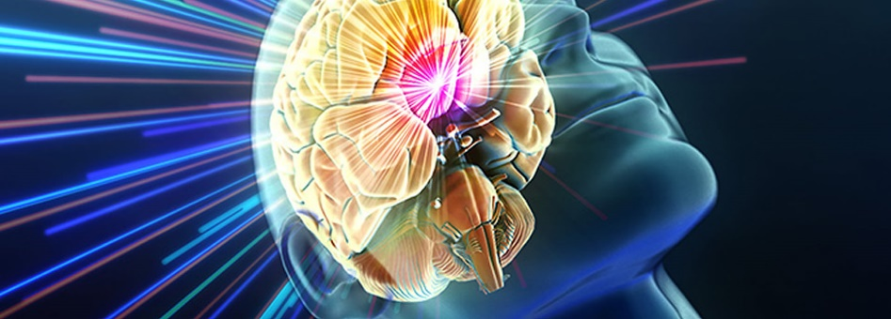
Frequency of presenting symptoms of FMD
Presenting symptoms | US Registry No (%) | Flandria
Hypertension | 285 (63) | 59.5 %
Headache | 234 (52.4) | 26.4 %
Pulsatile tinitus | 123 (27.5)
Dizziness | 116 (26.0) | 23.1 %
Cervical bruit | 99 (22.2)
Flank/abdominal pain | 70 (15.7)
Aneurysms | 63 (14.1) | 20.3 %
Cervical artery dissection | 54 (12.1) | 11.4 %
Olin JW, et al. Circulation. 2012;125:3182–3190.
De Groote M, et al. Fibromuscular Flanders. Vasa. 2017;46(3):211-218.

Slide 48
US Registry, Flandria
US : 921 patients:
Flandria: 123 (83.7 % female).
Aneurysm 21.6%,
Dissection 25.7%
Either aneurysm or dissection 41.7%
Mean age at FMD diagnosis: 57.3 y. (SD 15.8).
FMD incidentally in 10 patients (8.3 %).
Cerebrovascular event 22.8 %
Aneurysms 20.3 %
Arterial dissection 11.4 %.
FMD affected: renal (85.3 %), carotid (74.7 %), vertebral (39.8 %) arteries.
Fibromuscular Dysplasia Society of America (FMDSA). The US Registry for FMD.
www.fmdsa.org/research_network/fmd_registry. Accessed August 24, 2016.
Brinza EK, Gornik HL. Cleve Clin J Med 2016; 83(11 Suppl 2): 45-51.
De Groote M, et al. Fibromuscular Flanders. Vasa. 2017;46(3):211-218.

Slide 49
US FMD registry: Prevalence and vascular distribution of arterial aneurysm
 | N (%)
Aneurysm | 76/447 (17%)
Renal | 25/76 (32.9)
Carotid | 16/76 (21.1)
Aorta | 15/76 (19.7)
Celiac | 12/76 (15.8)
Cerebral | 9/76 (11.8)
Mesenteric | 5/76 (6.6)
Basilar | 5/76 (6.6)
Vertebral | 2/76 (2.6)
Subclavian | 2/76 (2.6)
Popliteal | 2/76 (2.6)
Olin JW, et al. Circulation. 2012;125:3182–3190.

Slide 50
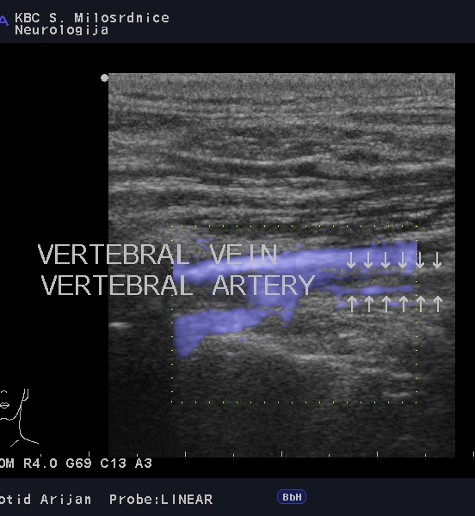
Beaded appearance long tubular stenosis
Kings coils

Slide 51
Multifocal stenosis and dilatation

Slide 52
Subtle changes

Slide 53
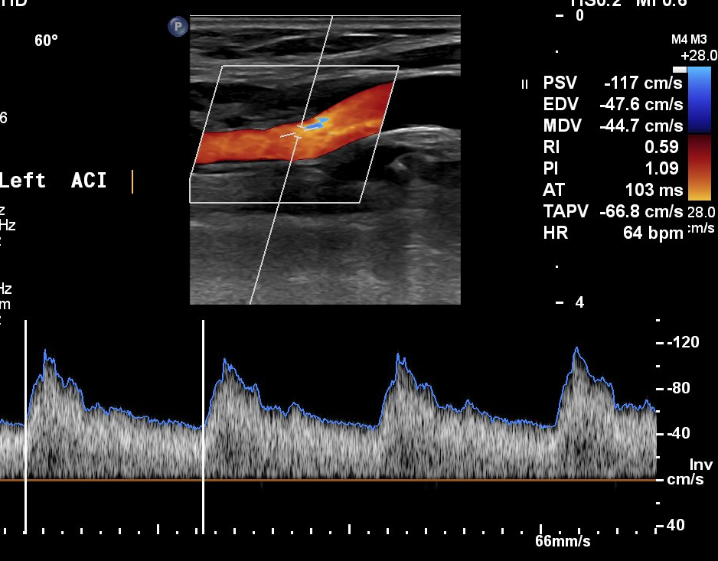
Better detection online than on freezed images

Slide 54
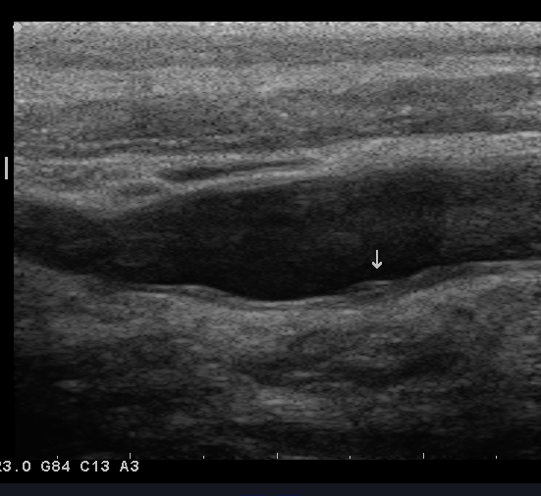
Increased IMT or focal increased IMT

Slide 55
Fusiform aneurysm or multifocal FMD with dilatations?

Slide 56
Carotid or vertebral aneurysm
ANEURYSM
LOOP

Slide 57
Female patient, 44 years old.
Frequent headache, migraine from puberty
Pregnancy at age 19 years, hypertension
25 years of OCT
Smoker
Carotid US: ICA stenosis, performed CTA
Brain CT scan normal
Referred to UHC Sestre milosrdnice

Slide 58
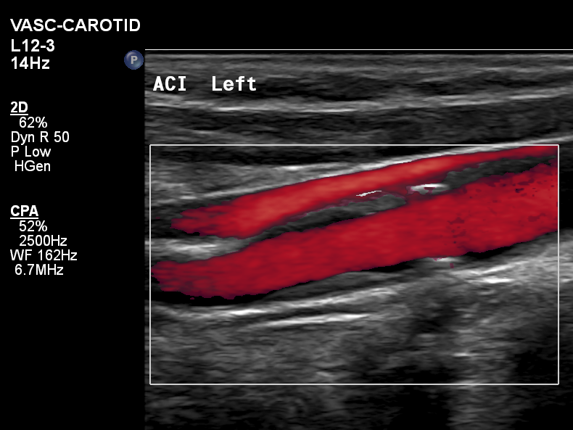
US imaging of carotid arteries

Slide 59
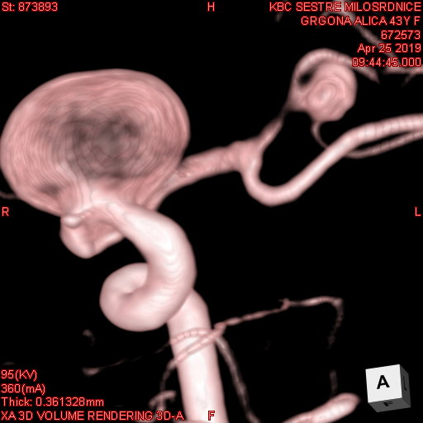
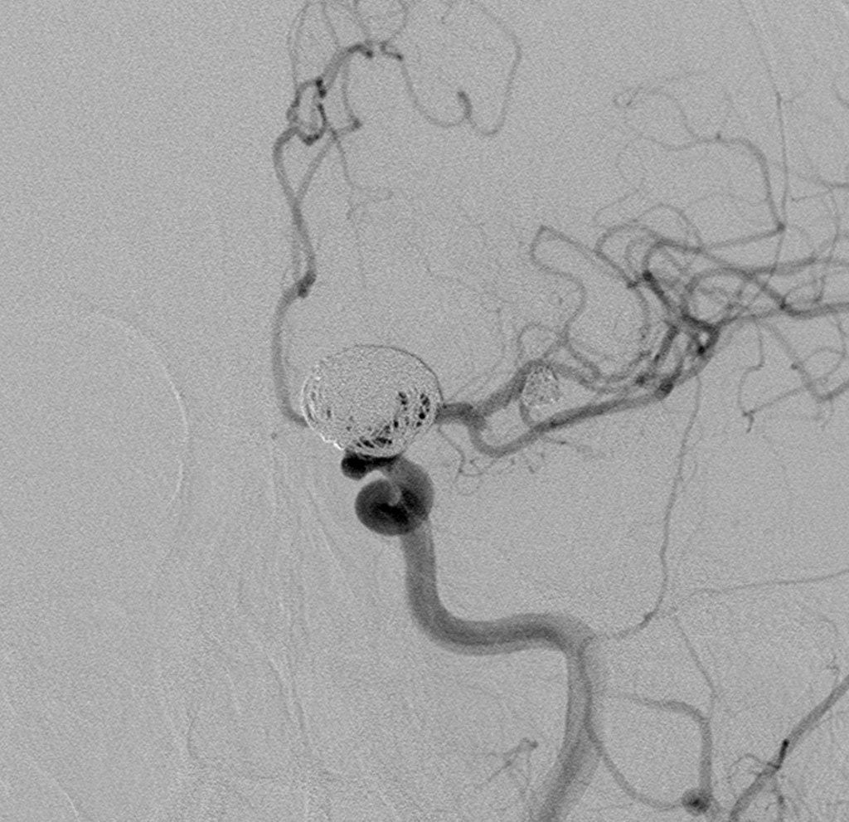
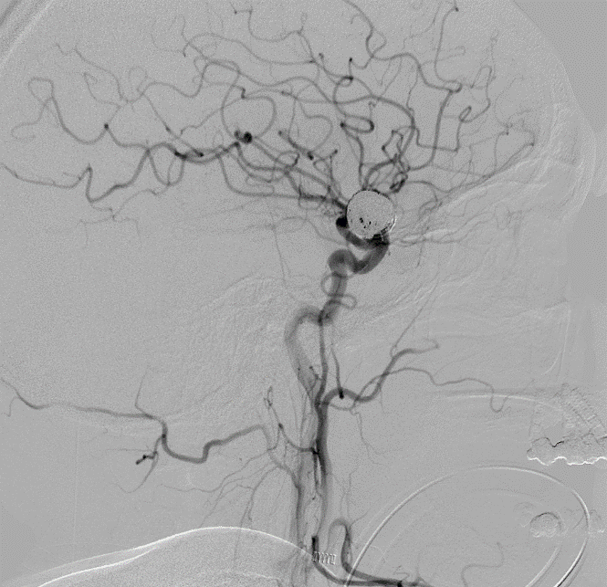
Intracranial imaging
Renal artery US: right renal artery FMD

Slide 60
Female patient, 46 years old
Presented to ED with headache started 2 days earlier with BP 200/120 mm Hg, at the day of presentation left side visual field flashes for ½ hour
BP 180/100 mm Hg
Eclampsia during pregnancy, from that time hypertension good controlled with medications
Non-smoker
Brain CT scan normal
Carotid US non-conclusive

Slide 61
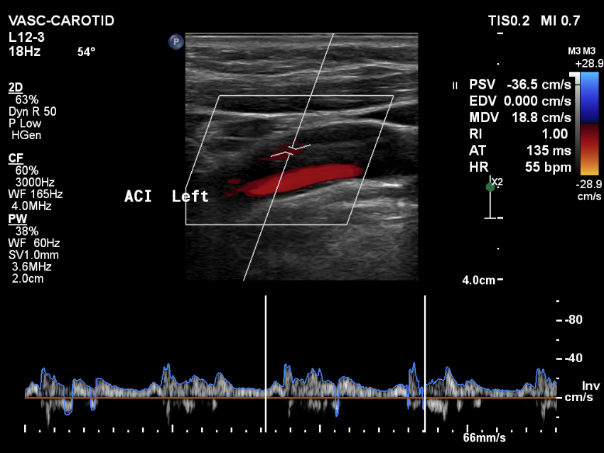
Carotid US

Slide 62
Carotid US transversal view

Slide 63
Neuroradiology

Slide 64
Carotid web

Slide 65
Oligosymptomatic female patient
Carotid web + multifocal FMD, tort. vertebral aa.

Slide 66
Geneticaly mediated arteriopathies
EDS IV (COL3A1)
Marfans (FBN1)
Loeys-Dietz (TGFβR1/2, TGFβ2, SMAD3)
ACTA2 (Genetic Aortic Disorders)
MYH11
MYLK

Slide 67
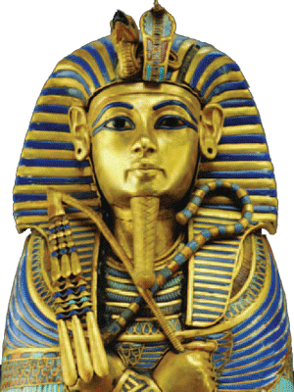
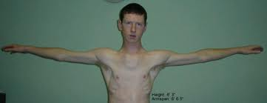
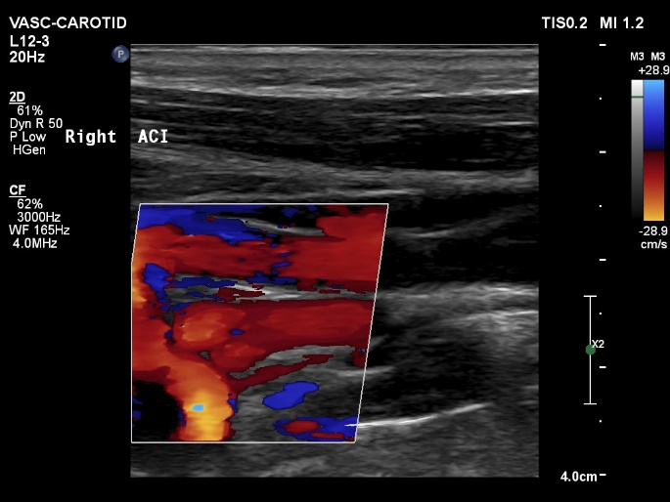
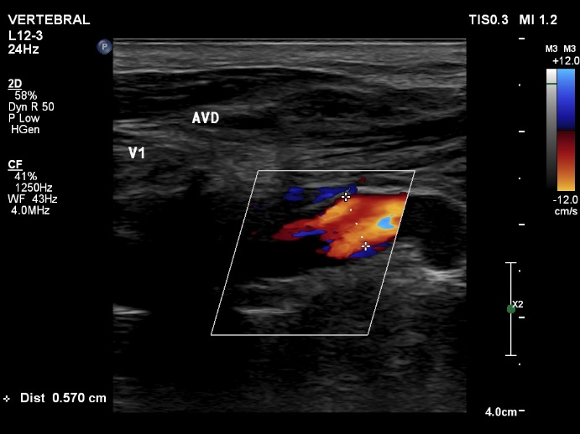
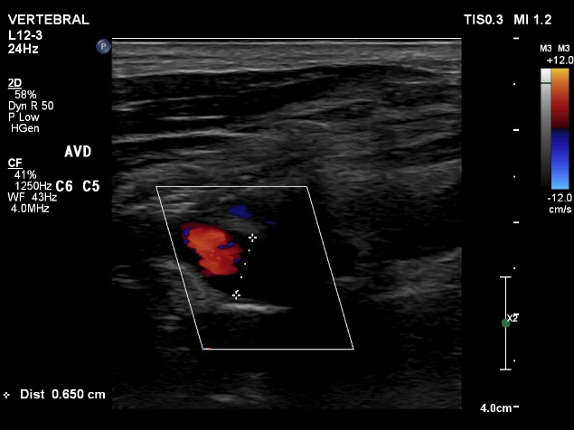
Marfan syndrom
Tortous arteries, focal dilatation

Slide 68
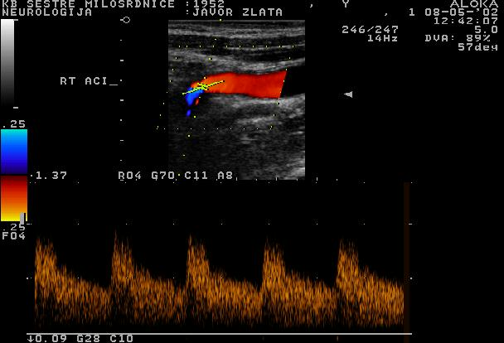
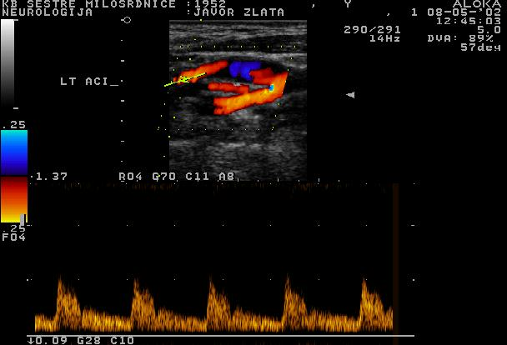
Anatomic variants
Hypoplasia/aplasia carotid artery

Slide 69
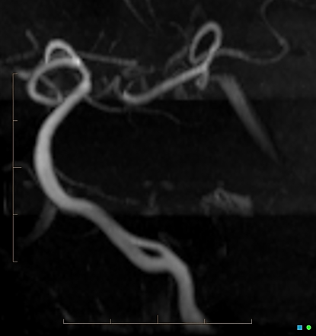
Anatomic variants
Fenestration of vertebral artery

Slide 70
Non-atherosclerotic disease
Just think on it!

Slide 71
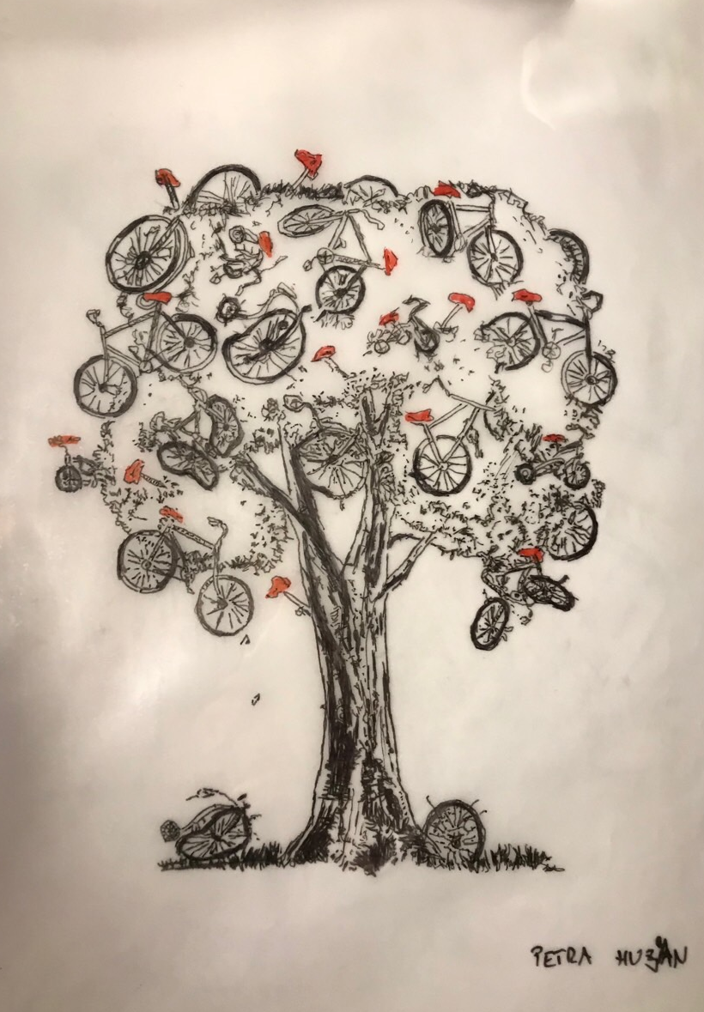
Thank you for your attention!

